Slide 1

yala
Iteration III
Jake Allen, Evan Berryman, Sam Hobbs

Slide 2
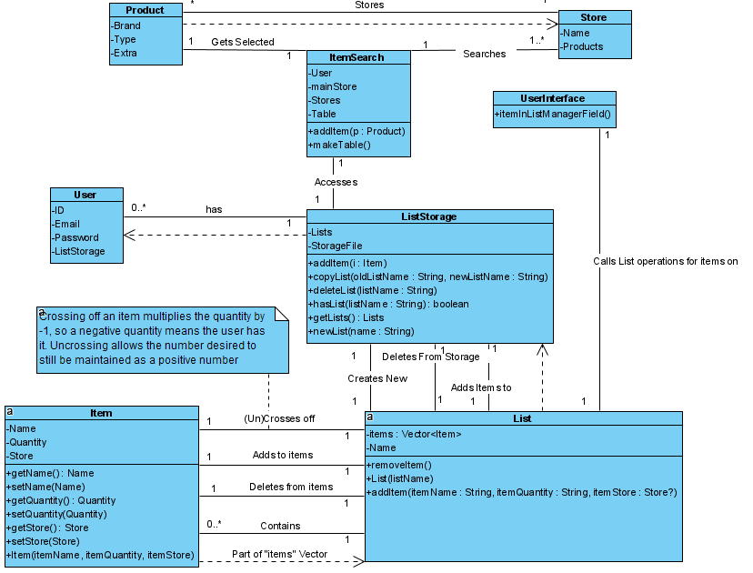

Slide 3
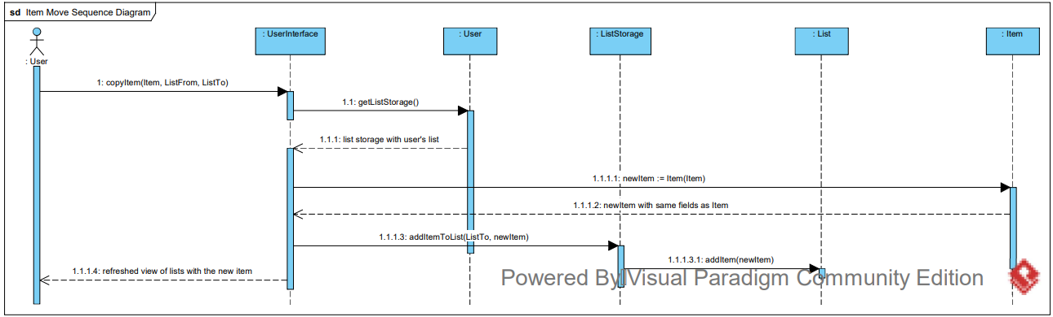
Searching for Items

Slide 4
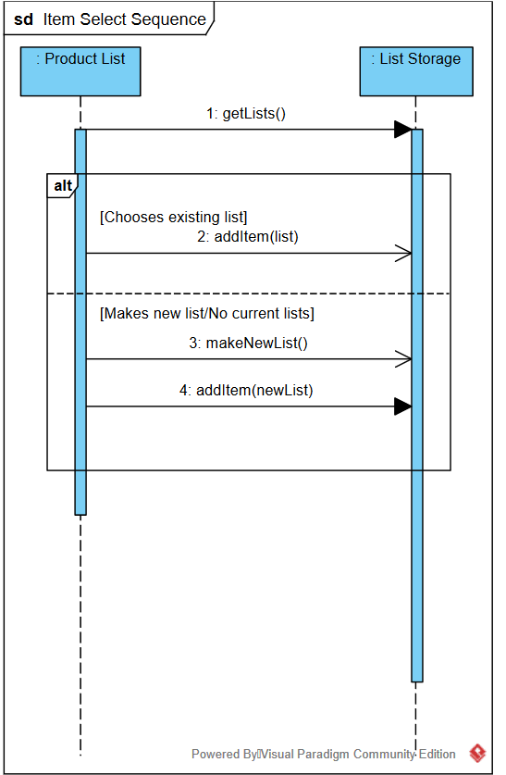
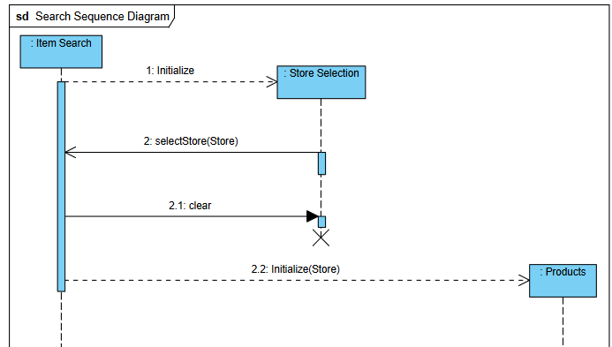

Slide 5
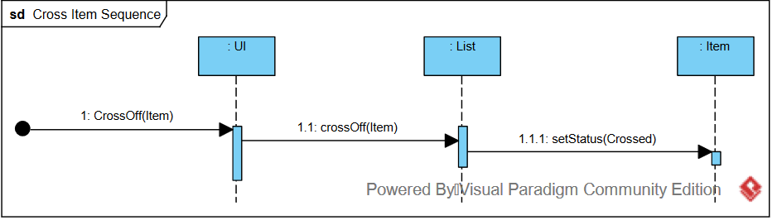
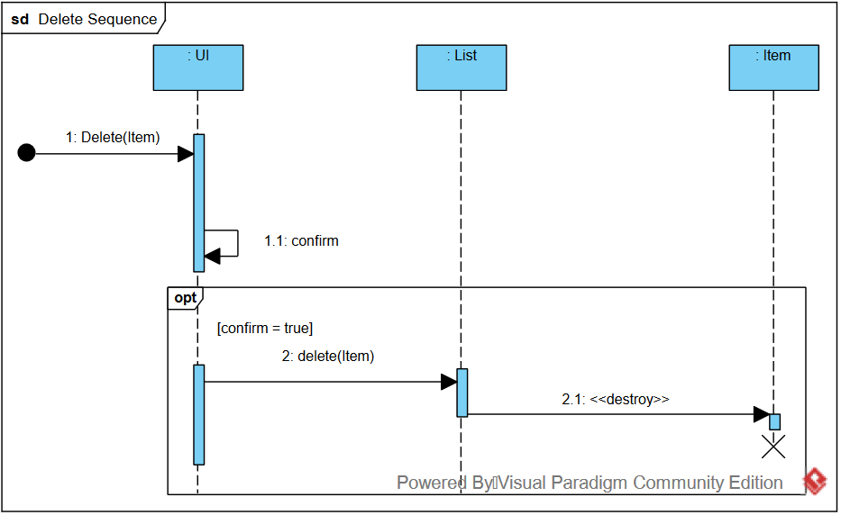
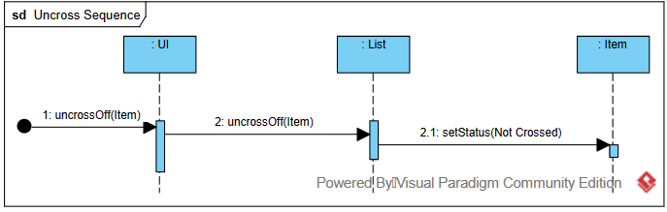
Item Management

Slide 6
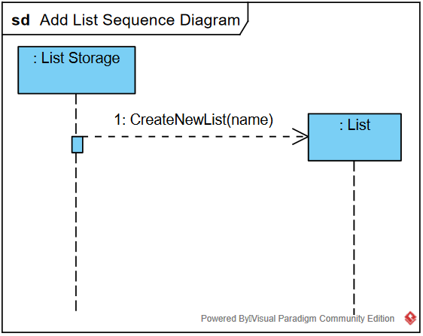
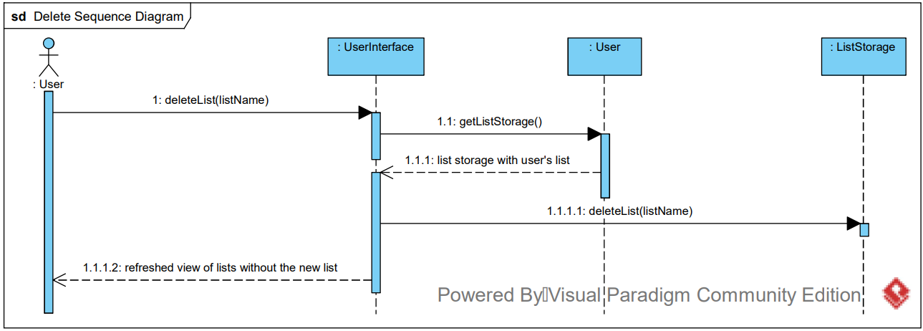
List Management

Slide 7
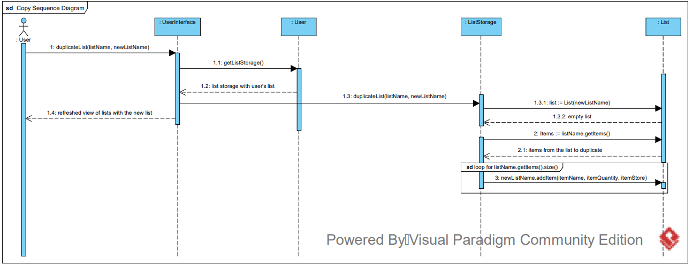

Slide 8
Test Cases
addAndDeleteList()
copyList()
addItem()
deleteItem()
crossItem()
uncrossItem()
storeSelect()
itemSearch() – not fully complete, does not seem to affect filters
All present and testable in UserInterfaceTest.java

Slide 9
Traceability Matrix
Requirements | Add List | Copy List | Delete List | Add Item | Select Store | Set Filter | Cross Item | Uncross Item | Delete Item
TC 1: addAndDeleteList() | ✓ |  | ✓
TC 2: copyList() | ✓ | ✓ | ✓
TC 3: addItem() | ✓ |  | ✓ | ✓
TC 4: deleteItem() | ✓ |  | ✓ | ✓ |  |  |  |  | ✓
TC 5: crossItem() | ✓ |  | ✓ | ✓ |  |  | ✓
TC 6: uncrossItem() | ✓ |  | ✓ | ✓ |  |  |  | ✓
TC 7: storeSelect() |  |  |  |  | ✓
TC 8 itemSearch() |  |  |  |  |  | Incomplete

Slide 10
Issue Tracking & Commits
Git commits: Total – 100, Jake – 49, Sam – 29, Evan – 22
Issues: General – 12 items, Jake – 36, Sam – 27, Evan – 25
Hours: Total – 129, Jake – 43, Evan - 42

Slide 11
Links
Project Hosting: https://github.com/jake-allen/YALA
Timecard tracking: https://trello.com/b/8JTgqSMS/yala
Website: https://jake-allen.github.io/YALA/

Slide 12
Questions? Concerns?

